Slide 1

Capstone Project on Insurance Claims
SHOP
Submitted By-
Manoj Gaikwad
Suraj Singh Bisht

Slide 2







Introduction
Insurance fraud is a significant concern for insurance companies worldwide, leading to substantial financial losses and undermining the integrity of the insurance system.
Detecting fraudulent activities efficiently is crucial for maintaining trust, reducing costs, and ensuring fair premiums for policyholders.
Machine learning (ML) techniques have emerged as powerful tools in combating insurance fraud due to their ability to analyze vast amounts of data and identify suspicious patterns that might.

Slide 3
Insurance Calims DATA ANALYSIS
Data Visualization (Python, Tableau, Power BI)
Exploratory Data Analysis (EDA)
Machine Learning (Python)
Data Collection
Database Queries (MySQL)
Ensure data integrity by collecting sales data from various sources (e.g., Kaggle, CSV files)
Create interactive visualizations using Python libraries such as Matplotlib, Seaborn and we have used Power Bi, Tableau also.
Apply machine learning techniques to predict The order is accepted or returned.
Explore the sales data using Python libraries like Pandas, NumPy, and Matplotlib/Seaborn.
Write SQL queries to extract relevant data from the MySQL database.

Slide 4


Data Collection
Ensure data integrity by collecting Insurance Claims data from various sources (e.g., Kaggle, CSV files).
We have read the data from excel and we understand the variables and we found out this data will be enough for analysis.

Slide 5




Exploratory Data Analysis (EDA)
Explore the Insurance Claims data using Python libraries like Pandas, NumPy, and Matplotlib/Seaborn.
Analyze Claims and correlation between the variables.

Slide 6
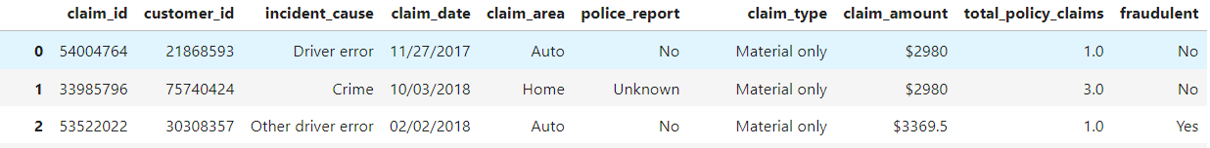
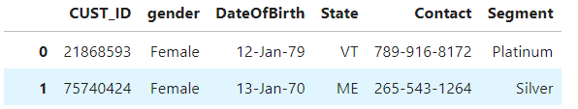
Exploratory Data Analysis (EDA)
We are having 2 datasets Claims and cust_demographics.
claims having 10 columns and this dataset store details about customers
cust_demographics having 6 columns and this dataset stores details about transactions and products codes.

Slide 7
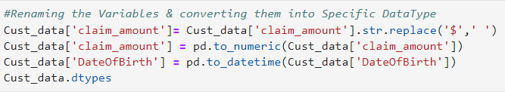
Exploratory Data Analysis (EDA)
Data Cleaning
Renaming the Variables & converting them into Specific DataType
After that we have merged all the dataset into one dataset and we saved it with Cust_data name.

Slide 8
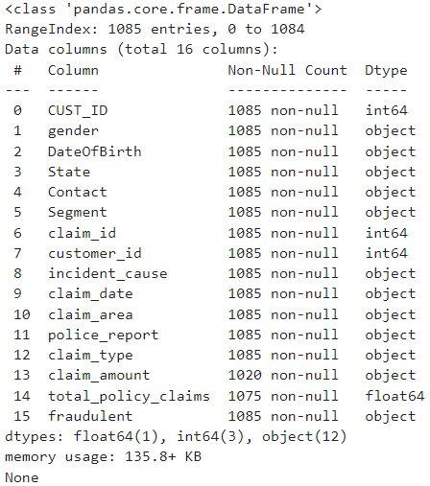

Exploratory Data Analysis (EDA)
We have used Inner join for merging the all the datasets and we used it coz there will be no duplicate values.
Now in our final datasets we are having 16 variables

Slide 9
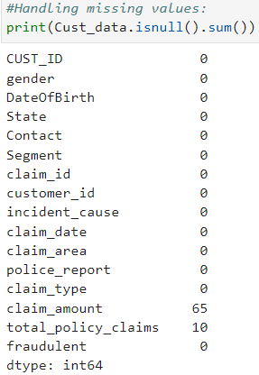

Exploratory Data Analysis (EDA)
We have check the info about our final dataset and we have checked for the null values. And we are having 65 null values in claim_amount and 10 null values are in total_policy_claims. we have replaced the null values with the mode(the number that appears most often in a set of data).

Slide 10
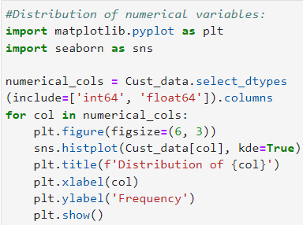
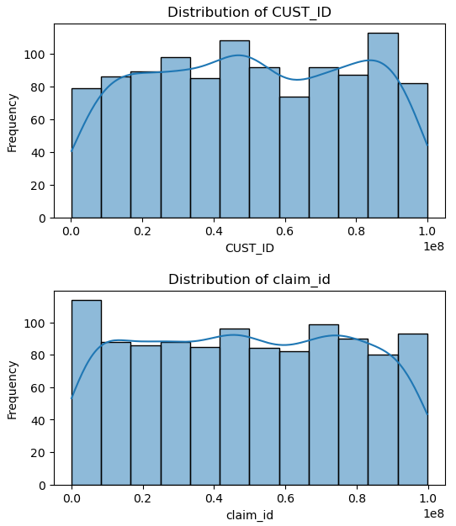
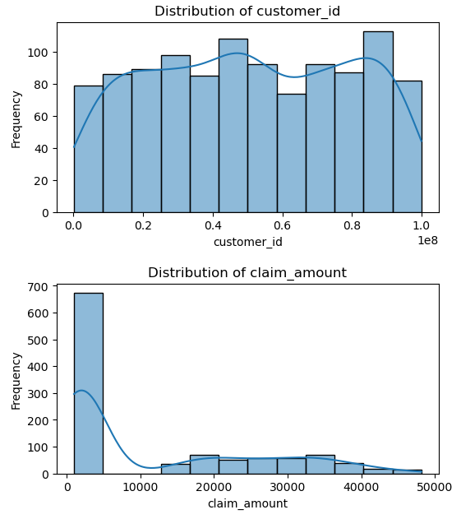
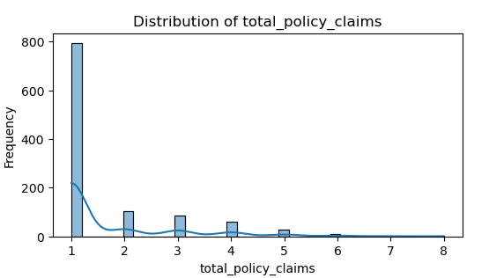
Exploratory Data Analysis (EDA)
Before checking for outliers ,we first for the distribution of the Numerical data in the data set.

Slide 11
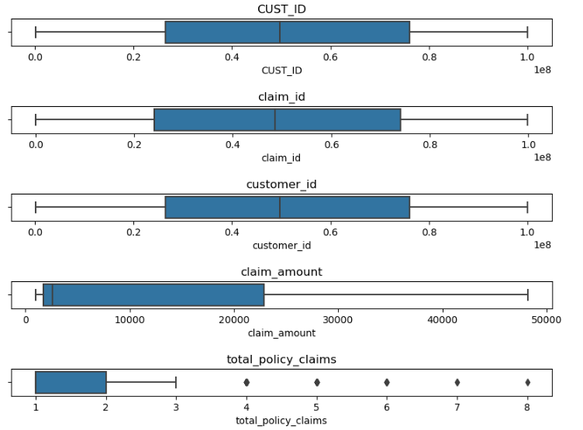
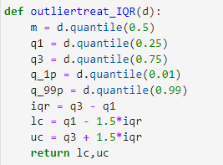

Exploratory Data Analysis (EDA)
We have check for the outliers in our dataset using seaborn boxplot and we have detected some outliers in 1 column i.e. “total_policy_claims” and treated them using clip method. We clipped them with upper bound and lower bound.
And we have found lower bound and upper bound using the UDF function.

Slide 12

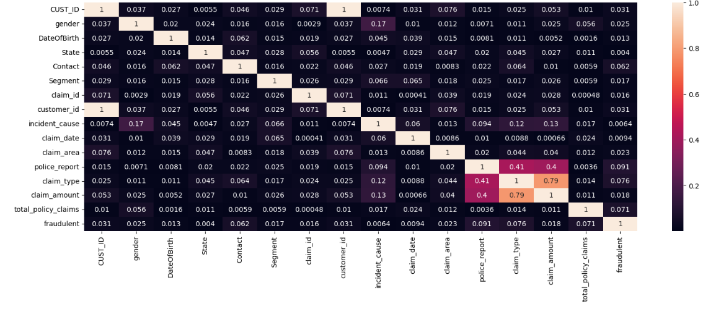
Exploratory Data Analysis (EDA)
Feature Engineering : Right here we used heat map for plot the correlation with our target variable “fraudulant”. And very less amount of variables having good relation with target variable Like – “claim_type, and “claim_amount”. So we decided that we are going to keep all the variables for next ML models.

Slide 13
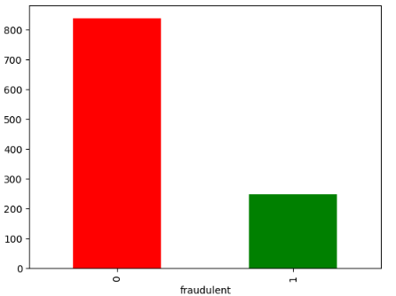
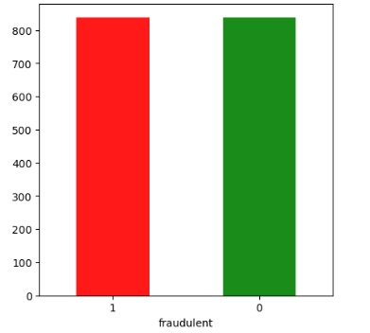
Exploratory Data Analysis (EDA)
We plotted our target variable to find out the balance of the data by using the bar graph but we found out that our data was highly unbalance so ,we have done over sampling
Before Over Sample
After Over Sample

Slide 14
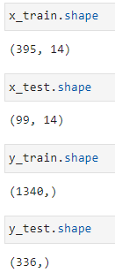
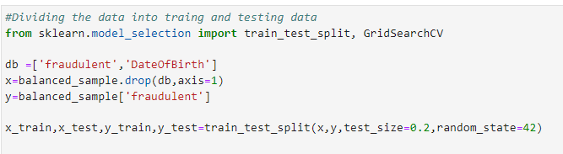
Machine Learning (Python)
Applying machine learning techniques to predict whether the claim has been granted or rejected.
These are the shape of our split data.
We have applied classifications models to predict the status of the claim “yes” or “No”.
And we split the data into test data and training data. Test having 20% of the dataset and training having 80% of the data.

Slide 15

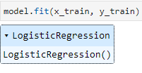
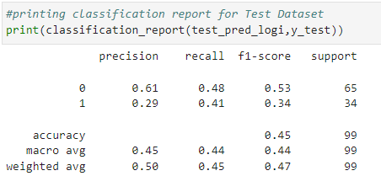
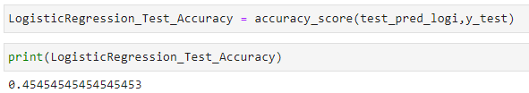
Machine Learning (Python)
Logistic regression model:
We initialize the Logistic Regression model with LogisticRegression() constructor.
We train the Logistic Regression model using the fit() method on the training data.
We use the trained model to make predictions on the test set using the predict() method.
We calculate the accuracy of the model by comparing the predicted values with the actual values in the test set using the accuracy_score() function.
Classification Report
Accuracy

Slide 16
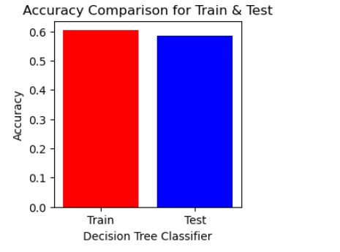

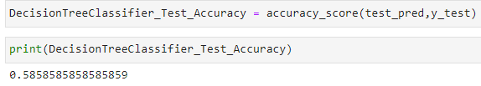
Machine Learning (Python)
Decision Tree: We initialize the Logistic Regression model with DecisionTreeClassifier() constructor.
We train the Decision Tree model using the fit() method on the training data.
We use the trained model to make predictions on the test set using the predict() method.
We calculate the accuracy of the model by comparing the predicted values with the actual values in the test set using the accuracy_score() function.

Slide 17
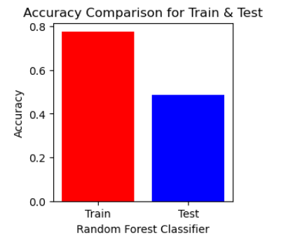

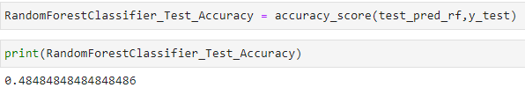
Machine Learning (Python)
Random Forest classifier Model:
We initialize the Random Forest Classifier with RandomForestClassifier() constructor. We specify the number of trees (n_estimators) in the forest. random_state is used for reproducibility.
We train the Random Forest Classifier model using the fit() method on the training data.
We use the trained model to make predictions on the test set using the predict() method.
We calculate the accuracy of the model by comparing the predicted values with the actual values in the test set using the accuracy_score() function.
Model Training

Slide 18
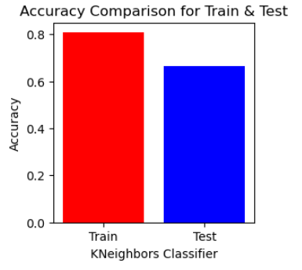
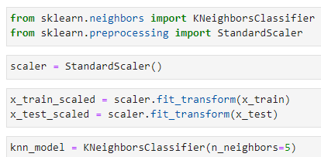
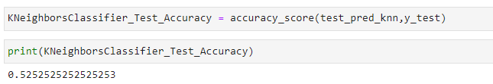
Machine Learning (Python)
K-Nearest Neighbors (KNN) Model:
We initialize the KNN model with KNeighborsClassifier() constructor. n_neighbors specifies the number of neighbors to consider.
We train the KNN model using the fit() method on the training data.
Making Predictions: We use the trained model to make predictions on the test set using the predict() method.
Model Evaluation: We calculate the accuracy of the model by comparing the predicted values with the actual values in the test set using the accuracy_score()
Model Training
Accuracy

Slide 19
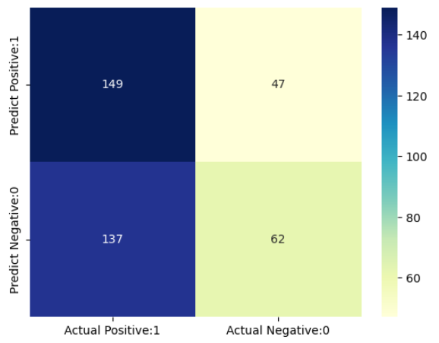
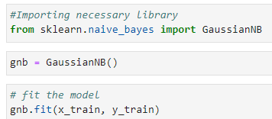
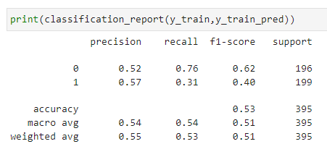
Machine Learning (Python)
Confusion Matrix
Naive Bayes Model:
We train the Naive Bayes model using the fit() method on the training data.
We use the trained model to make predictions on the test set using the predict() method.
We calculate the accuracy of the model by comparing the predicted values with the actual values in the test set using the accuracy_score() function. We also generate a classification report using classification_report() to get more detailed metrics like precision, recall, and F1-score.
Classification Report

Slide 20
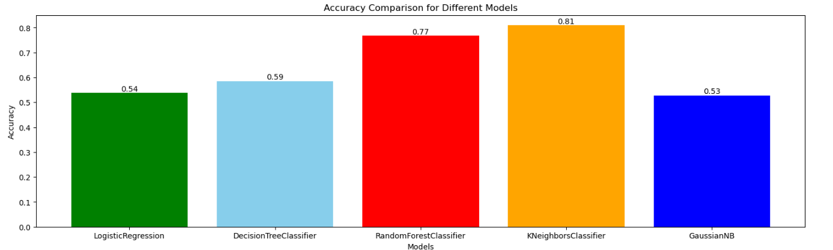
Machine Learning (Python)
Accuracy Comparison for Different Models
From the above comparsion we can conclude that RandomForestClassifier and KNeighborsClassifier has the highest accuracy.

Slide 21
Thank You

